Slide 1


No One is Safe
4 People Getting A’s
David Kim, Alex Dunmire, Rohan Nagarkar, Michelle Dean

Slide 2
Table of Contents
Goals
Functionality
Successes
Failures
Summary & Tradeoffs

Slide 3

Goal of the project
To make FPGA controlled cars that can communicate with an Android app controller through wifi or bluetooth…
...And also play laser tag!

Slide 4
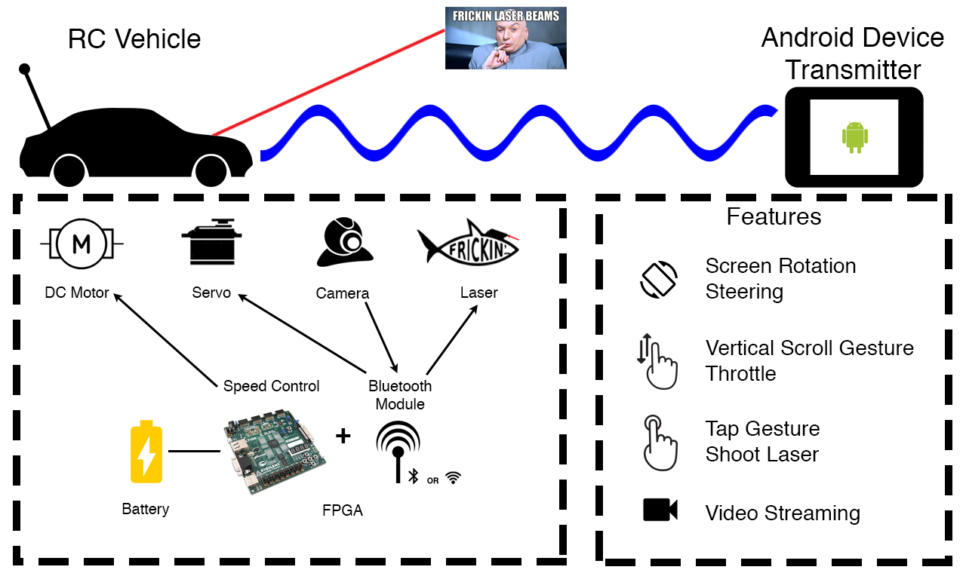
Short Functionality

Slide 5





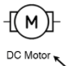
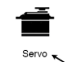
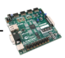

Project Attribution
Android App: David, Michelle
RC Car: Rohan, Alex
power/speed power/rotation FPGA control
Android/FPGA comm.
Camera
Bluetooth
Car controls
Laser controls

Slide 6
Short specification
Crawler
Nexys 3: steer car and control throttle, would capture camera data, send and receive data over wifi
VModCam: film from car’s perspective and output in RGB
Android device: run app, send commands over wifi, receive game data over wifi

Slide 7
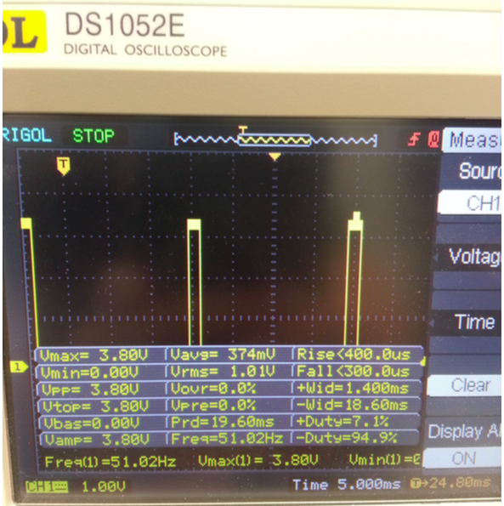
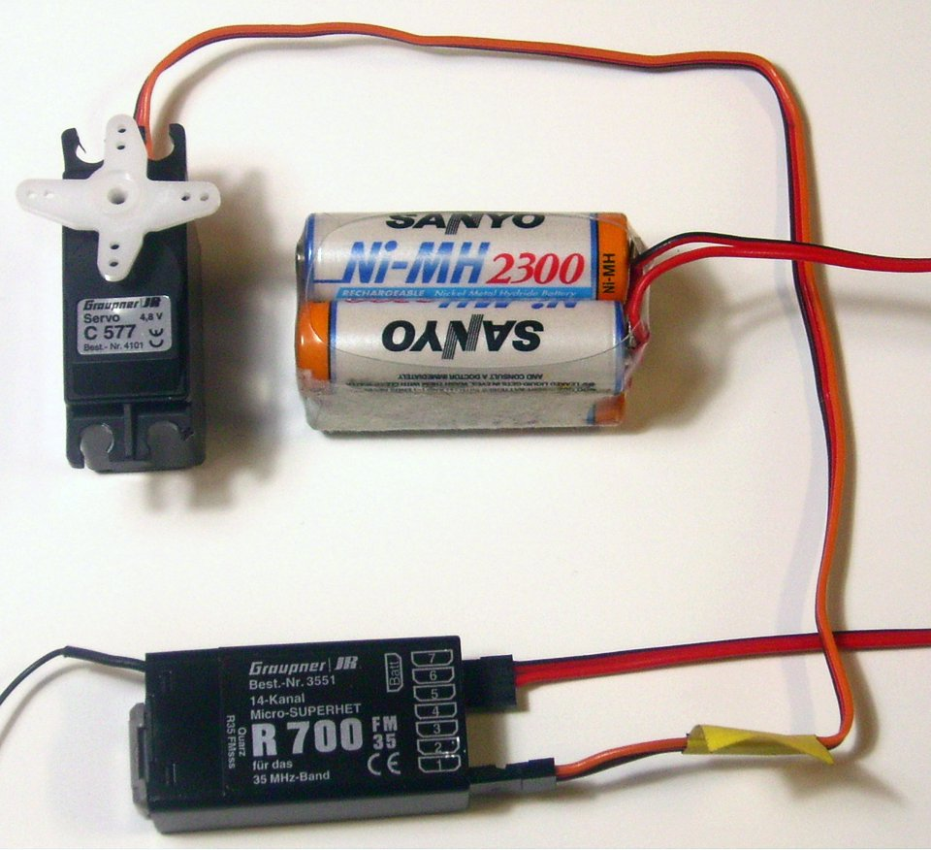
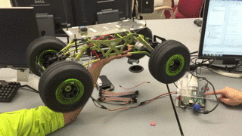
Emulating RC controller w/ FPGA
Measure Emulate

Slide 8
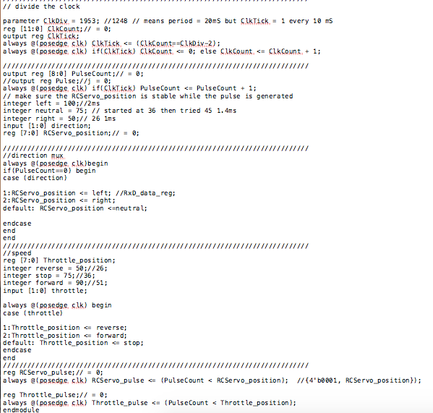
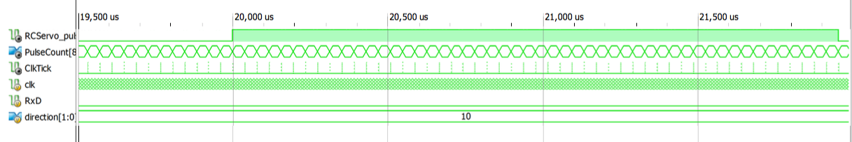
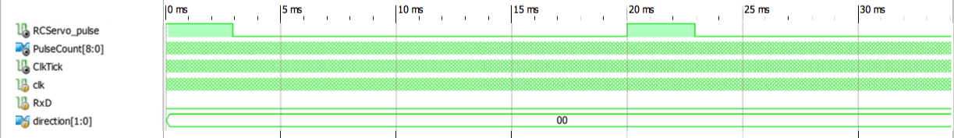

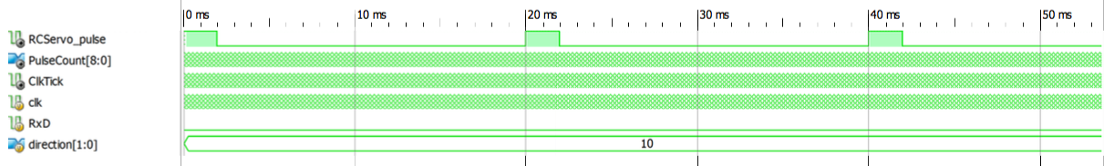
Emulating RC controller w/ FPGA cont.
100MHz/1953*512 =
10ms
ClkCount = 2^12
20ms period

Slide 9
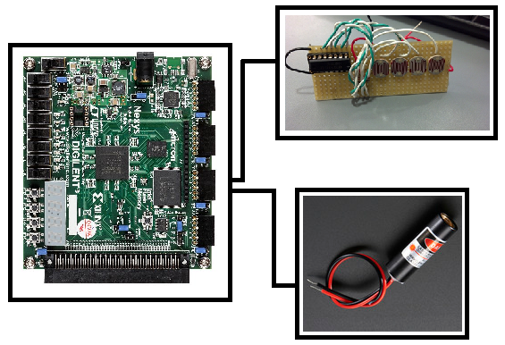
LASER Block Diagram
Detector
FPGA
Laser Diode

Slide 10
LASER BEAMS
Laser Diodes:
650nm wavelength, 5mW output power
Operates within 2.7 - 5.2 VDC range
Fires upon Button Press
Connected to PMOD output

Slide 11
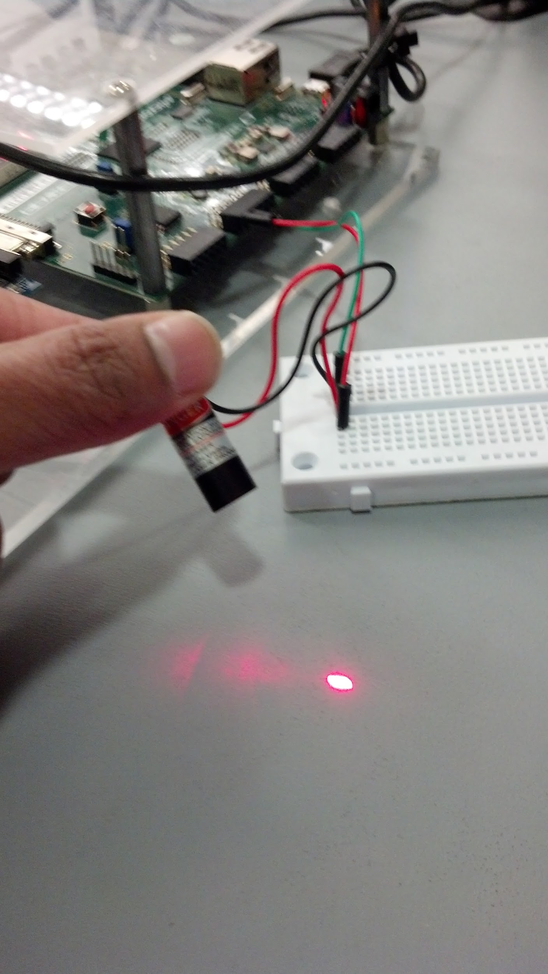
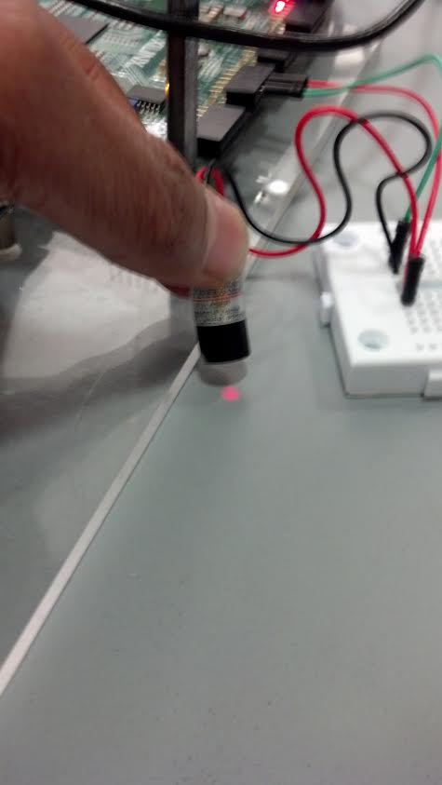
LASER BEAMS CONT.
module laser(clk,pb,laser);
input clk,pb;
output reg laser;
always @(posedge clk)begin
case (pb)
1: laser = pb;
default laser = 0;
endcase
end
endmodule

Slide 12
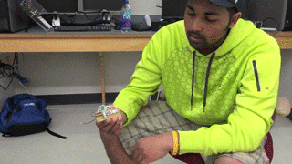
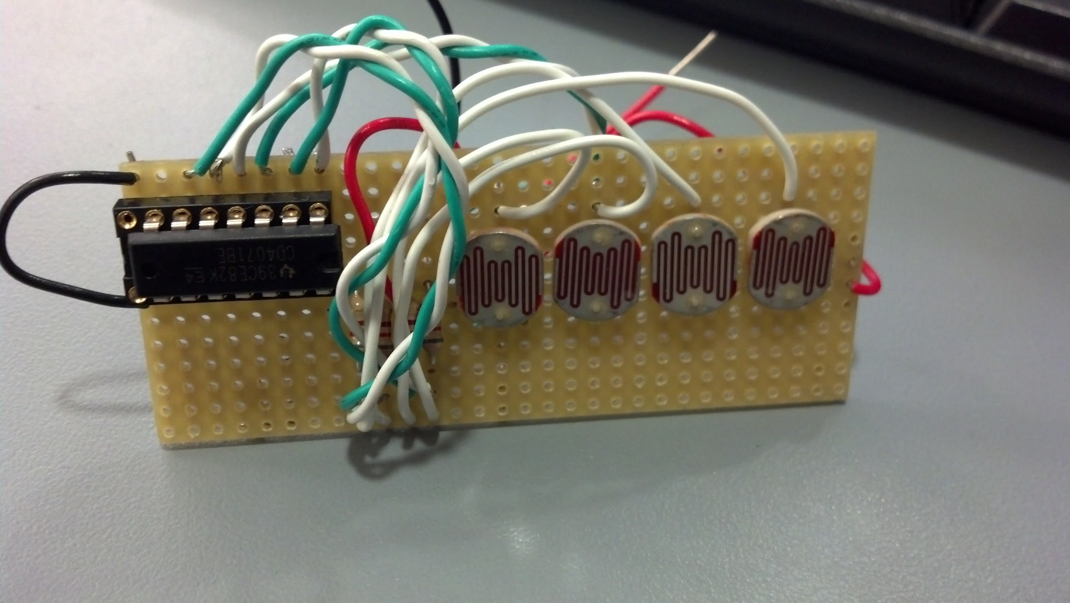
LASER DETECTOR
Laser Detector
Vin: 3.3 VDC
Vout:
V hit = 3.3 VDC
V miss = 50 mVDC

Slide 13
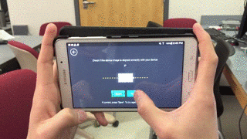
Android Controller
Controller steering uses Android’s
Accelerometer sensors. Due to limited availability
of gyroscopes on devices, our controller utilizes
control and stabilizes sensitivity using a
high-pass k-filter.
The starting net XYZ coordinate is “zeroed” by
the user which will then be incremented/decremented
by the filtered XYZ values.
After trial and error, the optimal k-value used to reduce noise and consistent control is 0.65f. The cutoff net value is set at +/- 5.0f (90 degrees).

Slide 14
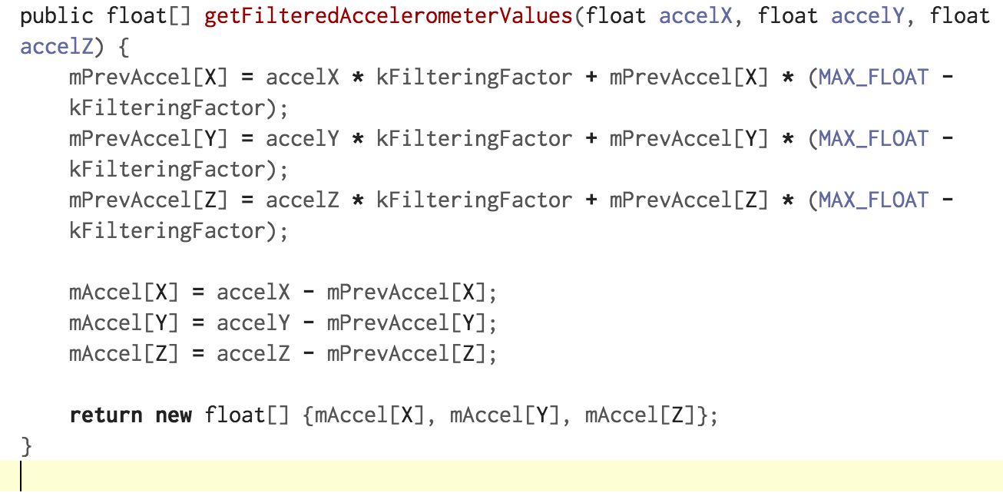
Android Controller
Filter algorithm:
The data that is transmitted from device to vehicle requires a minimum transmission rate of 1kbps, using 5-bit sequence in 20ms intervals. The syntax of an instruction is as follows.
bits[1:0] Steering Control 00 (no signal) 01 (right) 10 (left)
bits[3:2] 00 (no throttle) 01 (forward) 10 (backwards)
bit[4] 0 (no fire) 1(fire)

Slide 15
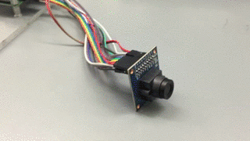
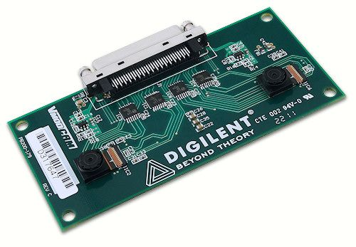
VGA camera
OmniVision 7670
SCCB Proprietary protocol
Cheap camera
Tradeoff: VModCam
Much more expensive
Simple I2C protocol
Example code exists online
Needs Atlys board (expensive battery, lack of PMod)

Slide 16
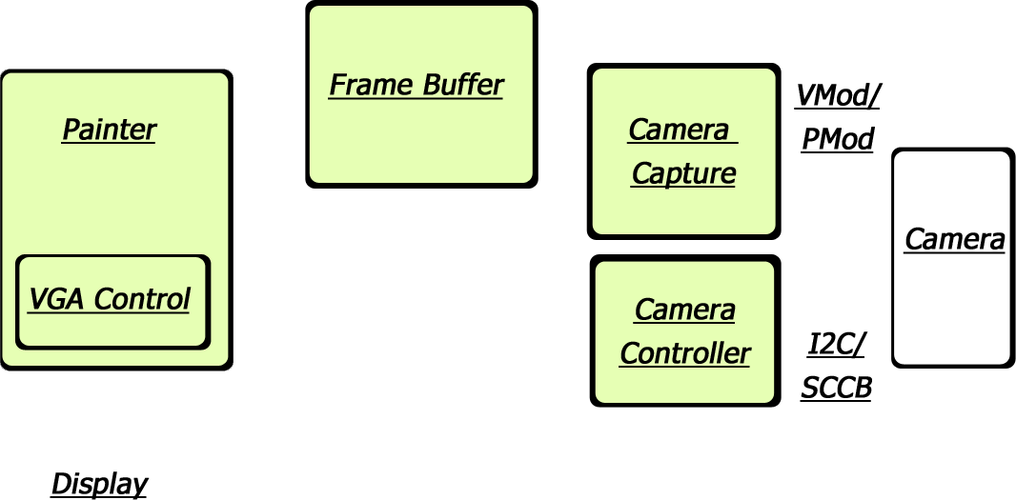
Camera block diagram
Obstacles

Slide 17
Design Tradeoffs
Car
Hack existing Laser Tag toy?
Nah, making our own is way cooler, (and cheaper)
Actual Lasers > IR beam of light
Bluetooth vs Wifi?
B
Cameras?
Add camera, lose PMod: not a viable option

Slide 18
Wi-fi
Early complications in trying to utilize a Wi-fi Pmod to transmit control signal to vehicle.
Much, if not all, of the internet protocol IP cores that are available for fpga’s are implemented using Vivado and C Language.
The Pmod Wifi module we are using provides a C language library that can be used. However, to incorporate this library into our design requires us to incorporate a tcp/ip protocol stack to our board.
After much searching, we were able to use Xilinx ISE’s Embedded Development Kit (EDK) and the BSB file provided on Nexys3’s documentation website.
However, Licensing issues arose (failure to mention incompatible support for ISE 14.7 version)
Have been able to make some progress recently using older version.
Might not have enough time to incorporate it in time.

Slide 19
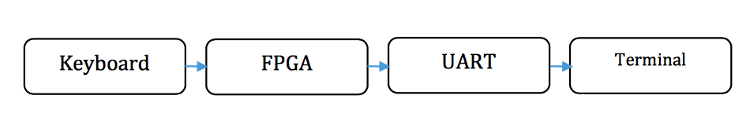
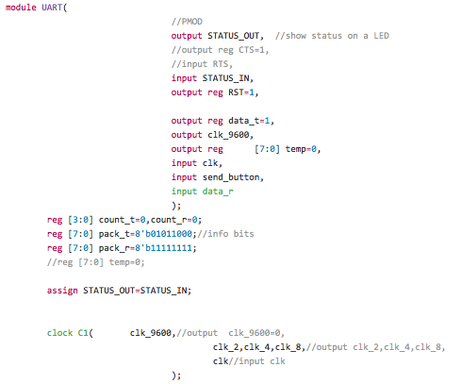
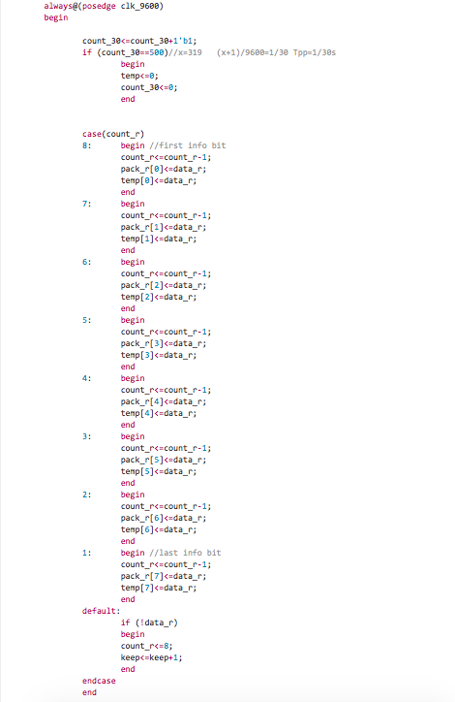
Bluetooth
Bluetooth
UART/USB port
FPGA
Servos and Speed Controller

Slide 20
Successes
Servos: Turn Right and Left
Motor Controller: Forward and Reverse Throttle
Shoot Laser Beams!!!

Slide 21
Fails
OmniVision Camera
proprietary configuration bus protocol: OV does not provide good documentation on 2 wire SCCB
VModCam
Requires memory on Atlys board, not enough PMod ports on Atlys for all project components

Slide 22
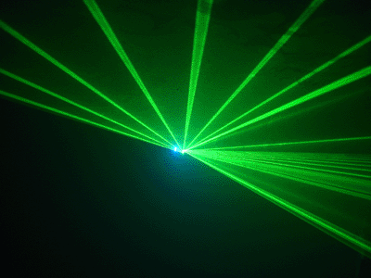
Thank you!
Gif from: http://www.animateur-dj-71.com/eclairage.php

